Slide 1
ANALYSIS PHASE
Original From:
Object-Oriented Systems Analysis And Design With UML
By Robert V. Stumpf
And
Lavette C. Teague
Expanded by: Ferreiras.

Slide 2
.
Object-Oriented
System Analysis

Slide 3
JOB MADE UNTIL THIS MOMENT
See following slides

Slide 4
INITIATION PHASE
PROJECT CHART
BUSINESS CASE
 | INITIATION PHASE
 | - System request - ...
- System Request

Slide 5
DEFINITION PHASE
SYSTEM REQUEST
 | DEFINITION PHASE
 | - Feasibility Analysis - Activity Diagram - System Proposal - ...
- Feasibility Analysis
- Activity Diagrams
- System Proposal

Slide 6
JOB TO BE MADE NOW
See following slide

Slide 7
ANALYSIS PHASE
SYSTEM PROPOSAL
 | ANALYSIS PHASE
 | - Event tables - Use Cases Diagram - Use Case Description - Domain Model ( Classes Diagram ) - ...
- Event tables - Use Cases Diagram - Use Case Description - Domain Model

Slide 8
Overview
 The principal goal of information systems analysis is to state accurately users’ requirements for a new information processing system.
 A six-step process is follow to produce an event model, a use case model, system sequence diagrams, a model of the problem domain, and system operation contracts.

Slide 9
Goals of Systems Analysis
 Primary Goal
To state accurately the users’ requirements for a new information processing system;

Slide 10
Goals of Systems Analysis
(continued)
 Secondary Goals
 To understand the users’ requirements;
 To communicate the current understanding of the proposed system
 To prevent expensive mistakes
 To state a design problem
 To state the conditions for system acceptance;

Slide 11
Characteristics of a Statement of System Requirements
Graphic: Uses diagrams
Partitioned: Organizes the system description into comprehensible parts
Non-redundant: A change can be made in a single place
Accurate: Rigorous, precise, clear, consistent, and complete
Minimal: Eliminates non-essentials, while including all critical details

Slide 12
Procedure for Object-Oriented Systems Analysis
Step 1. Identify the business events and
make an event table.
Step 2. Identify the use cases and produce
a use case diagram for the system.
Step 3. Write a use case narrative
describing the system’s response
to each business event.

Slide 13
Procedure for Object-Oriented Systems Analysis (continued)
Step 4. Draw a system sequence diagram
for each use case scenario.
Step 5. Produce a domain model showing the concepts, attributes, and associations in the problem
domain of the system.
Step 6. Write a contract for each system operation.

Slide 14
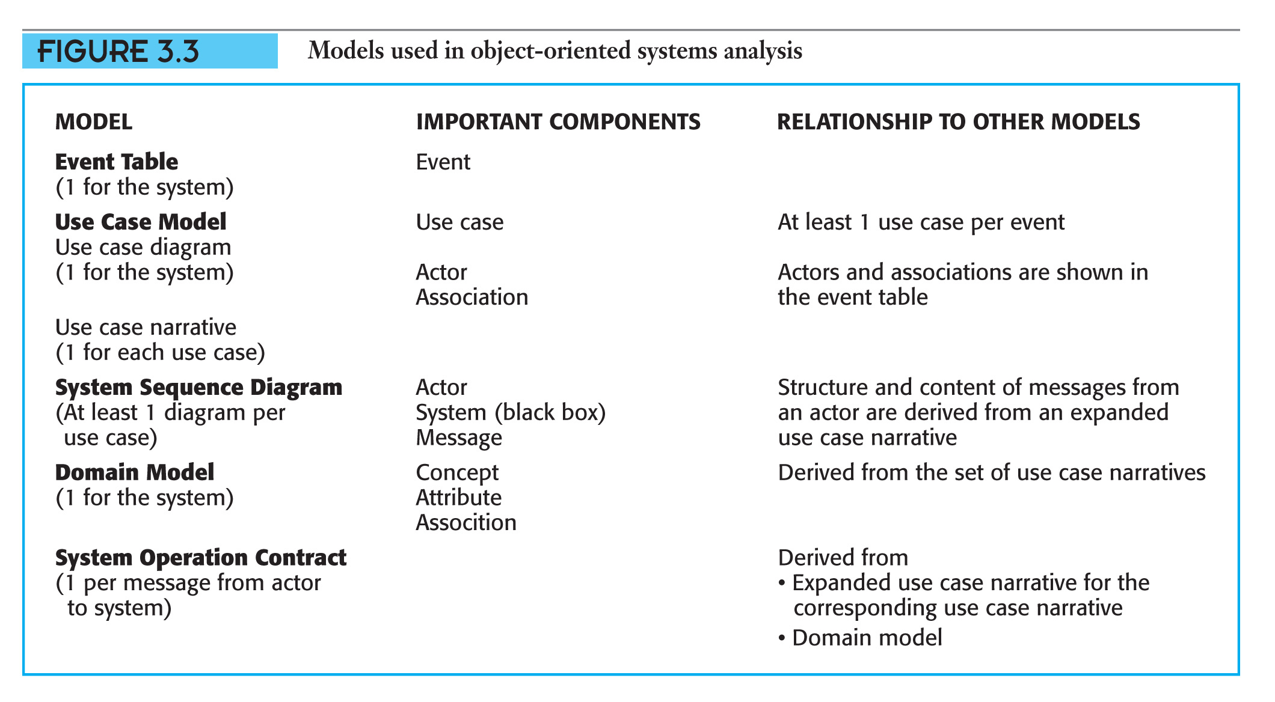
Models for Object-Oriented Systems Analysis
.

Slide 15

Domain Model
Is a static model of the structure of a problem domain. It models real-world concepts rather than software units. It is composed of:
 Concepts;  Attributes of concepts; And  Associations between concepts.
Domain model are generated from the use case, one use case at a time.

Slide 16
Domain Model
A domain model show the concepts, attributes, and associations in the problem domain of the system. For example

Slide 17

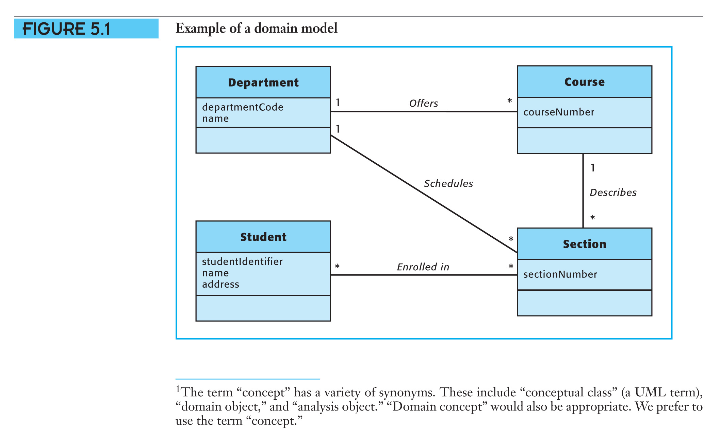
Domain Model
.

Slide 18
Concepts, Attributes, and Associations
A concept is an abstraction of a thing,
a person, or an idea. It is represented
by a rectangle.
An attribute is a characteristic of a
concept which may have a value.
Attribute names appear in the lower compartment of the concept rectangle.
An association is a significant connection between concepts. It is represented by a line connecting a pair of concepts.

Slide 19
Concepts
Identifying and adding concepts to
the domain model is part of the process for object-oriented systems analysis.

Slide 20
Finding Concepts
1. Look for nouns or noun phrases describing the problem domain;
2. Use a checklist of concept categories. (See on the next slide, -ff-)

Slide 21
Finding Concepts
Concept Category | Examples
Business transactions | Sale, rental, purchase, payment, loan
Business transaction line items | Sale line item
Catalogs | Product catalog, parts catalog
Containers | Bin, car, room, airplane
External systems | Credit-card Authorization System
Organizations | Sales Department, ariline
Places | Store, airport, library, parking, building,
Roles of people | Student, customer. professor, employee
Specifications or descriptions of things | Product specifications, book specification
Tangible objects | Cash register, desk, video, board, seat, computer.
Things in a container | Stock item, passenger.
bin: a large container or enclosed space for storing something in bulk, such as coal, grain, or wool

Slide 22
Finding Concepts
Include a concept in the domain model when the system needs to store data about the concept to respond to a future event.

Slide 23
Finding Concepts
Distinguish between concepts and attributes which describe concepts: Both concepts and attributes are important to the model, but they have different roles.

Slide 24
Finding Concepts
Exclude concepts which represent system outputs unless the system needs to know about then in the future:: For example, class list can be omitted as concept from the model but Tuition Bill should be a concept in the model.
Tuition: Charge for instruction

Slide 25
Finding Concepts
System output can not be ignored, however. Their attributes must be defined as a basis for user interface design. An output may be documented either in the UML form for a message or as a concept ( or set of related concepts) in a domain model.
Tuition: Charge for instruction

Slide 26
Finding Concepts
Any data elements needed to produce an output in response to a event must be contained in a system input, must be an attribute in the domain model, or must be able to be calculated from inputs, and attributes.
Tuition: Charge for instruction

Slide 27

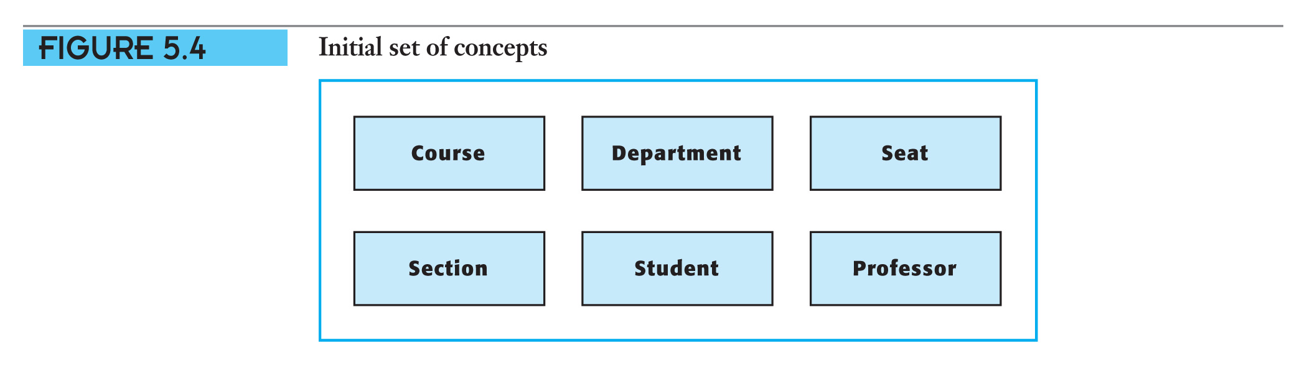
Concepts
.

Slide 28
Attributes
Identifying and adding attributes to the domain model is part of
the process for object-oriented systems analysis.

Slide 29
Attributes
In general, the search for attributes is a quest for the necessary descriptive data to be stored for each concept. Normally, while we search for concepts, we found also the attributes of this concepts.

Slide 30
Attributes: Criteria for including in the domain model
 Include an attribute in a domain model when the system needs to remember the value of the attribute in order to respond to an event;
 If in doubt as to whether something is an attribute or a concept, define it as a concept in the initial model;

Slide 31
Attributes: Criteria for including in the domain model
 Do not use an attribute to record a connection between concepts; use an association instead;
 Do not include the same attribute as an attribute of more than one concept;
 Do not include an attribute if it can be derived or calculated from other attributes in the model;

Slide 32
Attributes
(continued)
Attributes describe concepts.
Concept | Student | Professor | Section
Attributes: | studentIdentifier | professorIdentifier | number
 | studentName | professorName | meetingTime
 | studentAddress | professorAddress | meetingPlace
 | major classLevel | title | maximum NumberOf Students

Slide 33

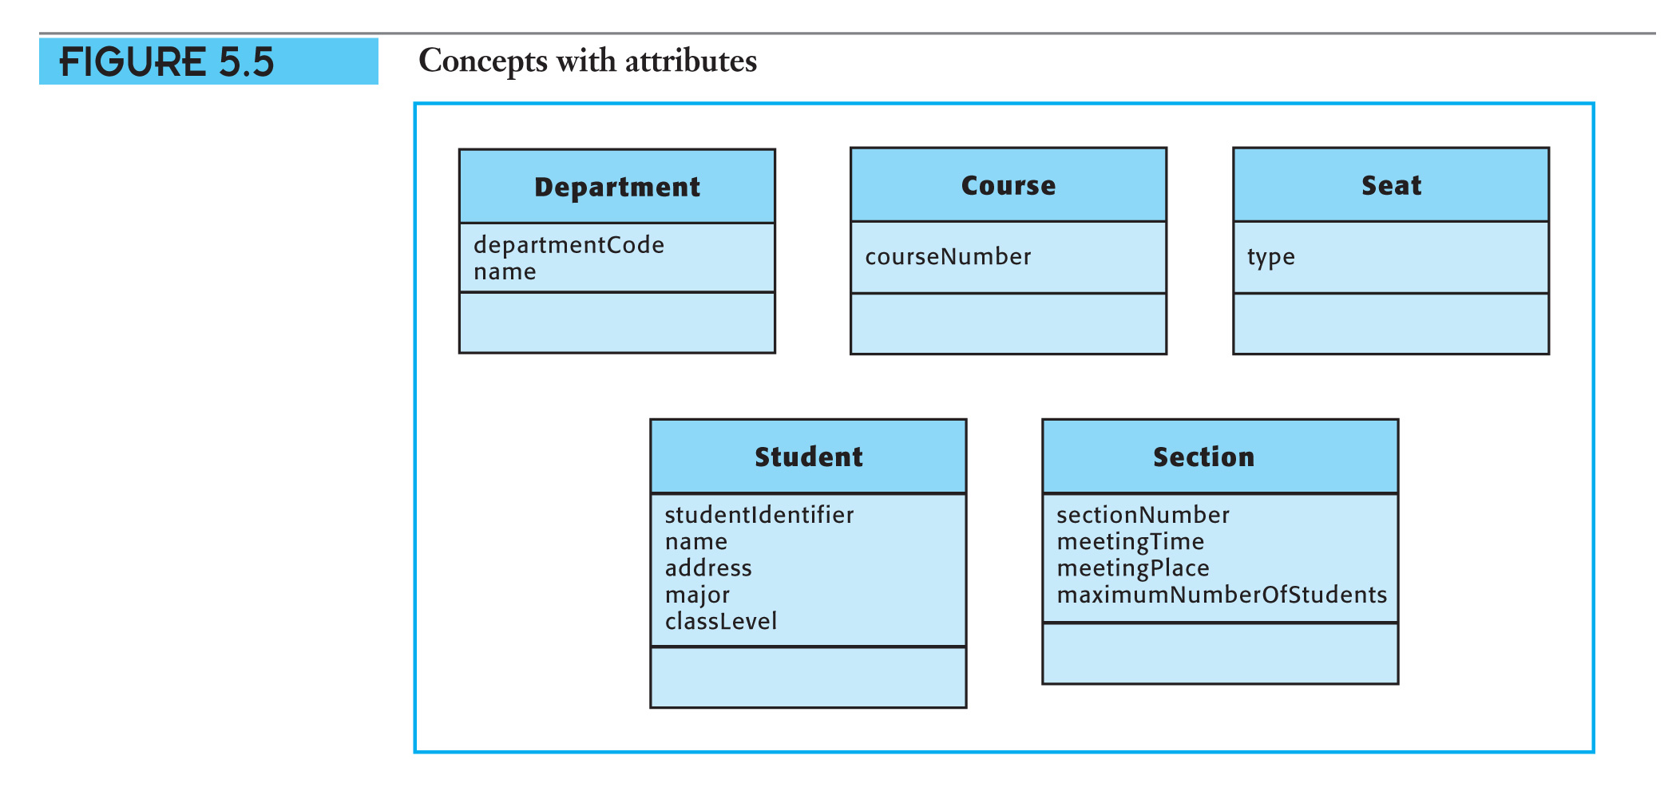
Attributes
(continued)
.

Slide 34
Attributes and Instances
An instance of a concept is a specific occurrence of a concept type.
Student Concept: | Student Instance 1: | Student Instance 2:
Attributes | Values | Values
studentIdentifier | 40168 | 82704
studentName | Louella Fernbee | Mortimer Snow
studentAddress | 123 Any St. | 456 Some St.
major | CIS | CS
classLevel | Junior | Sophomore

Slide 35
Associations
Identifying and adding associations to the domain model is part of the process for object-oriented systems analysis.

Slide 36

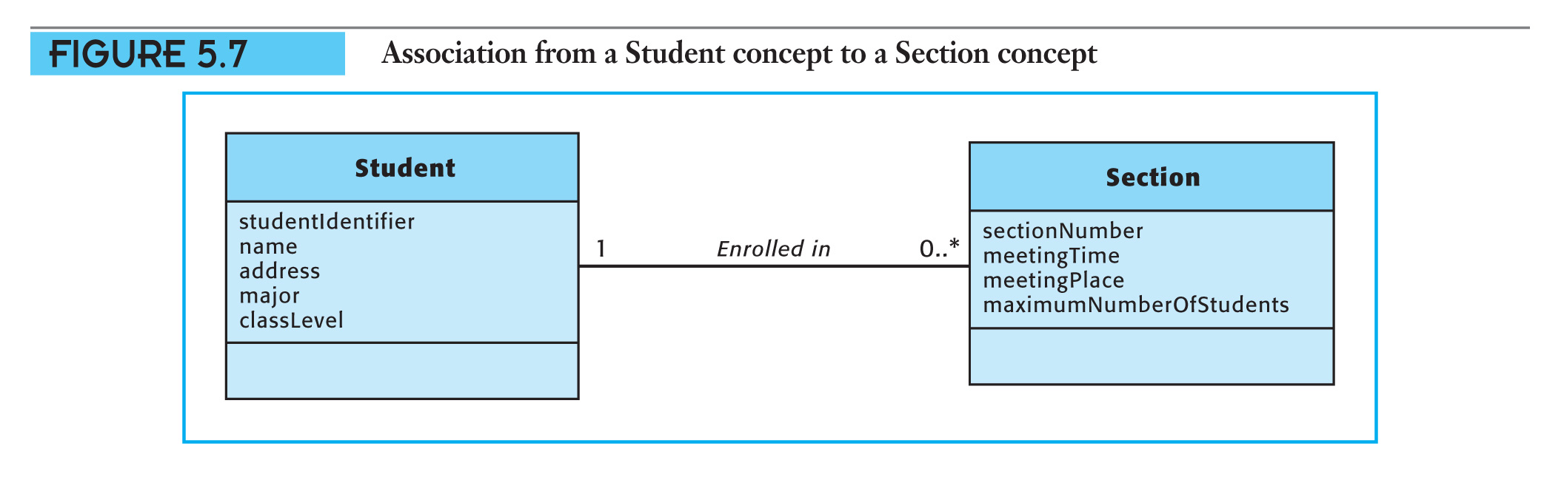
Associations
(continued)
.

Slide 37
Associations
(continued)
Always model associations explicitly; never use an attribute to imply an association.

Slide 38

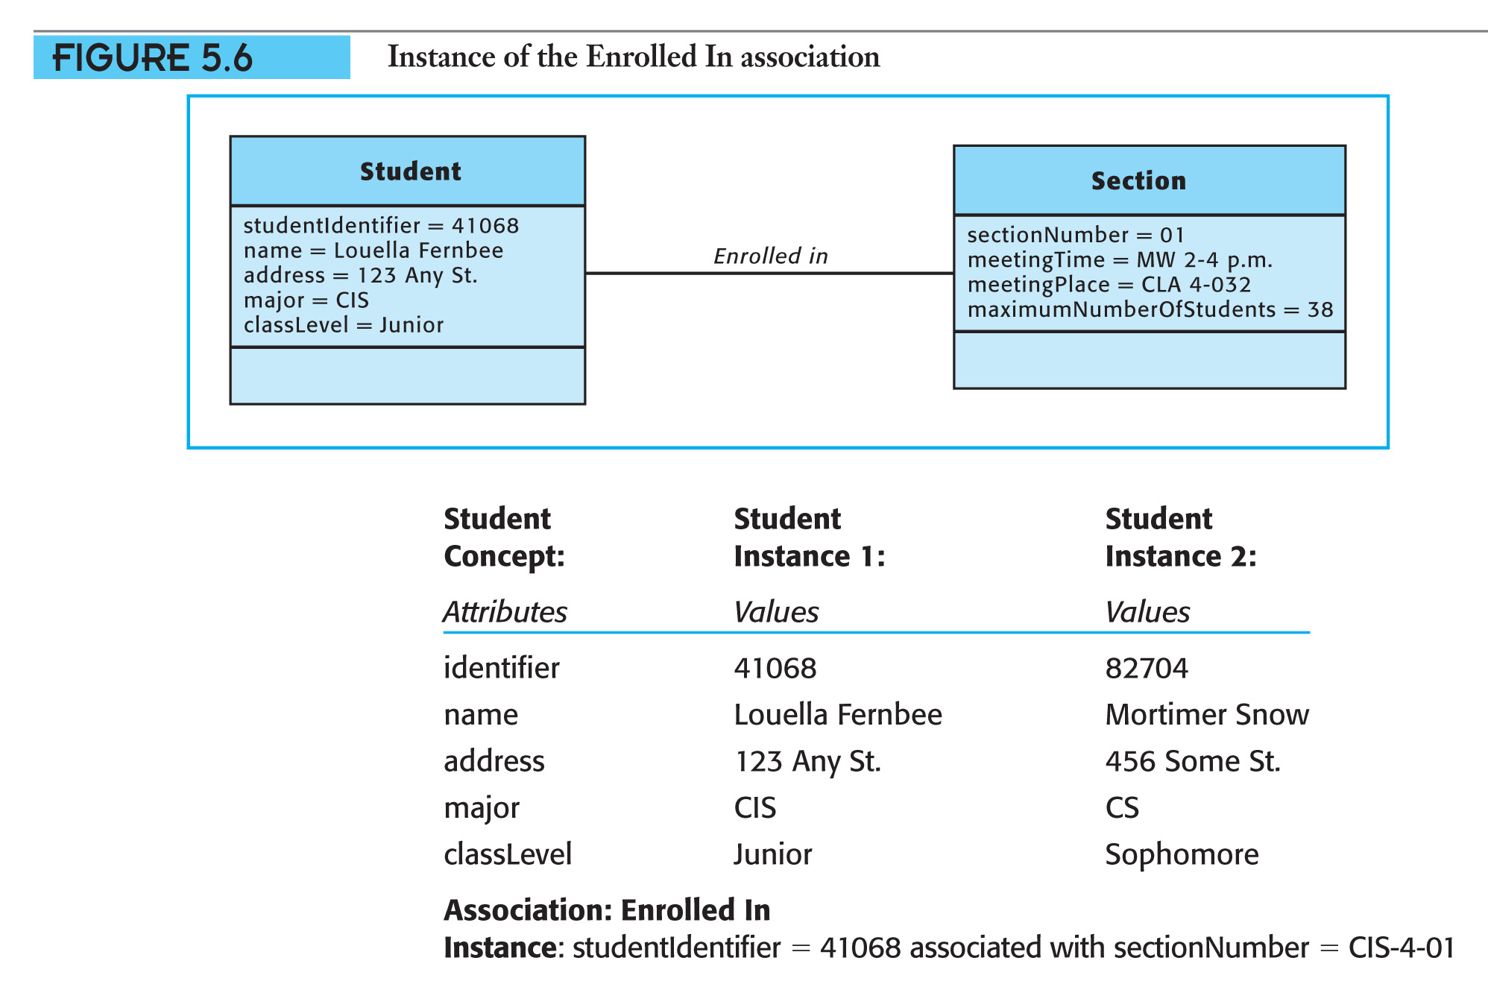
Instances of Associations
There are instances of associations as well as instances of concepts.
Association: Enrolled In
Instance: studentIdentifier = 41068 associated with sectionNumber = CIS-4-01

Slide 39

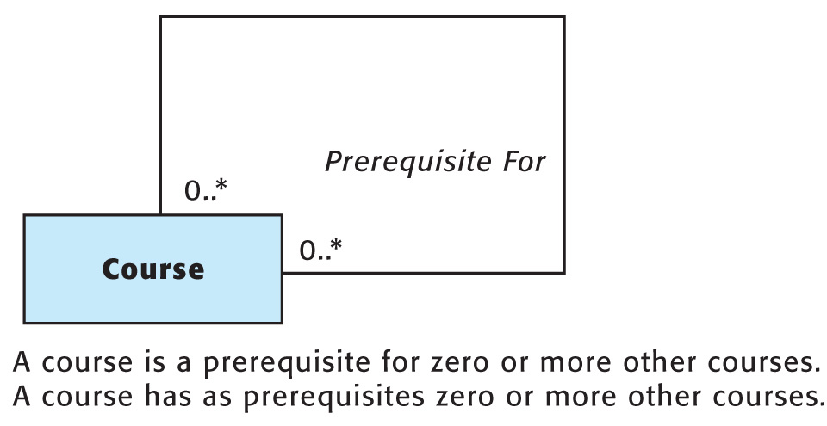
Reflexive Associations
A concept may be associated with itself.

Slide 40

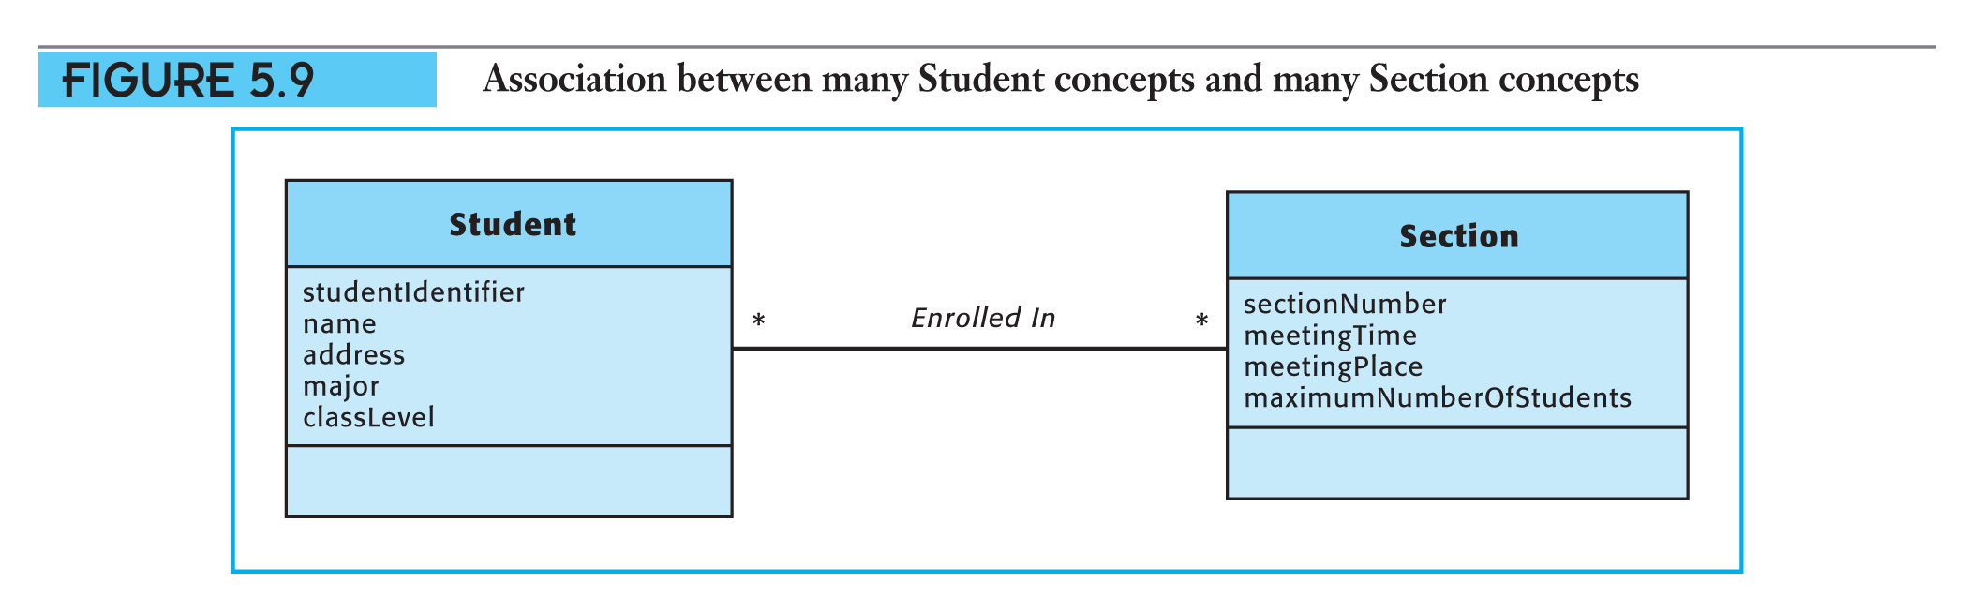
Multiplicity of Associations
The multiplicity of an association is the number of instances of a concept which can be associated with one instance of another concept.

Slide 41
Multiplicity of Associations
(continued)
Each end of an association is labeled with the minimum and maximum values of its multiplicity.
0 .. 1
1 .. 1
.. * signifies unlimited (more or many)
* alone means zero or more

Slide 42
Whole-to-Part Associations
The UML provides ways to model two types of whole-to-part associations – aggregation and composition.

Slide 43

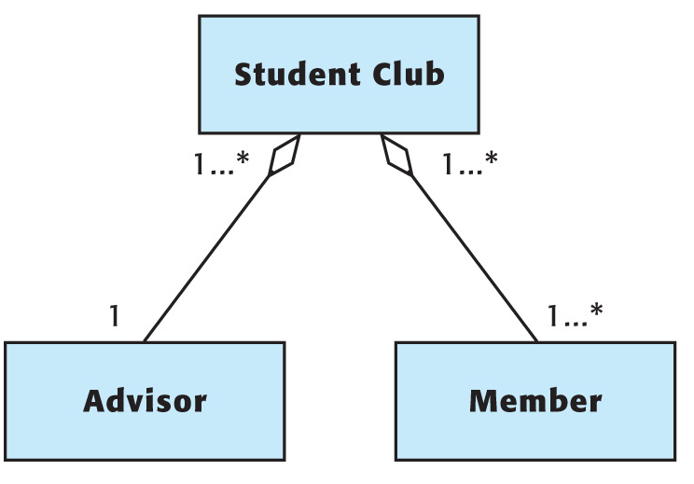
Example of an Aggregation
.

Slide 44

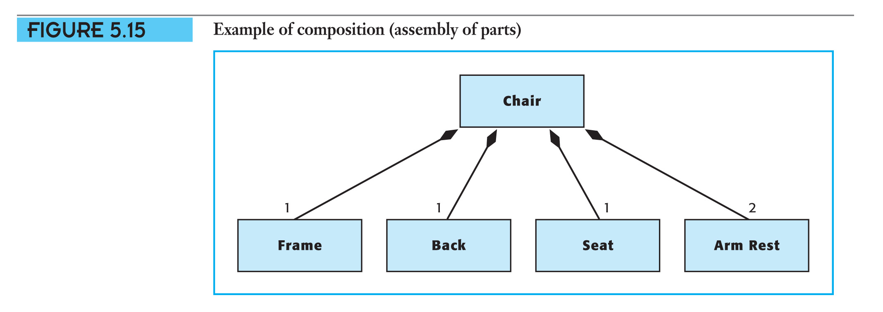
Example of a Composition
.

Slide 45

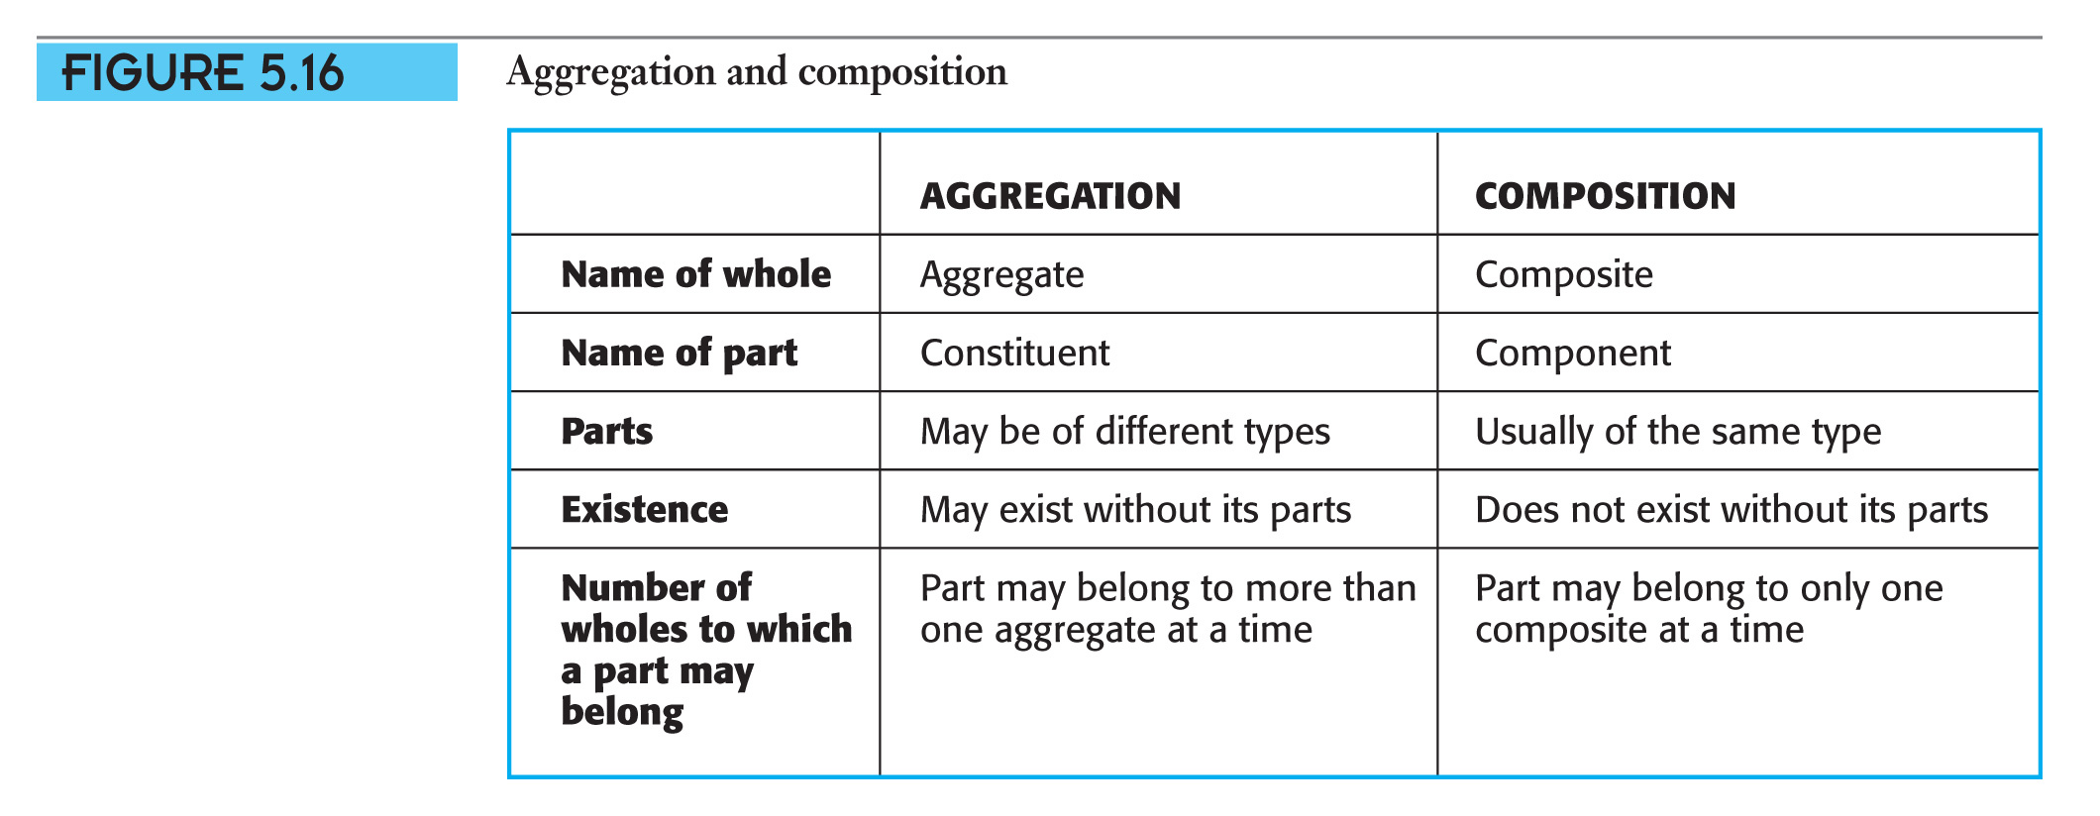
Aggregation and Composition
.

Slide 46
Categories of
Whole-to-Part Associations
Assemblies of parts
Members of groups
Containers and their contents

Slide 47
Associations and Generalization-Specialization Hierarchies
Identifying and adding associations
and generalization-specialization hierarchies to the domain model
is part of the process for
object-oriented systems analysis.

Slide 48
Generalization-Specialization Hierarchies
A generalization-specialization hierarchy classifies a type of concept into its subtypes.
Every instance of a subtype must also
be an instance of its supertype.
Subtypes have the same set of attributes as their supertype. These attributes are not duplicated in the domain model.

Slide 49

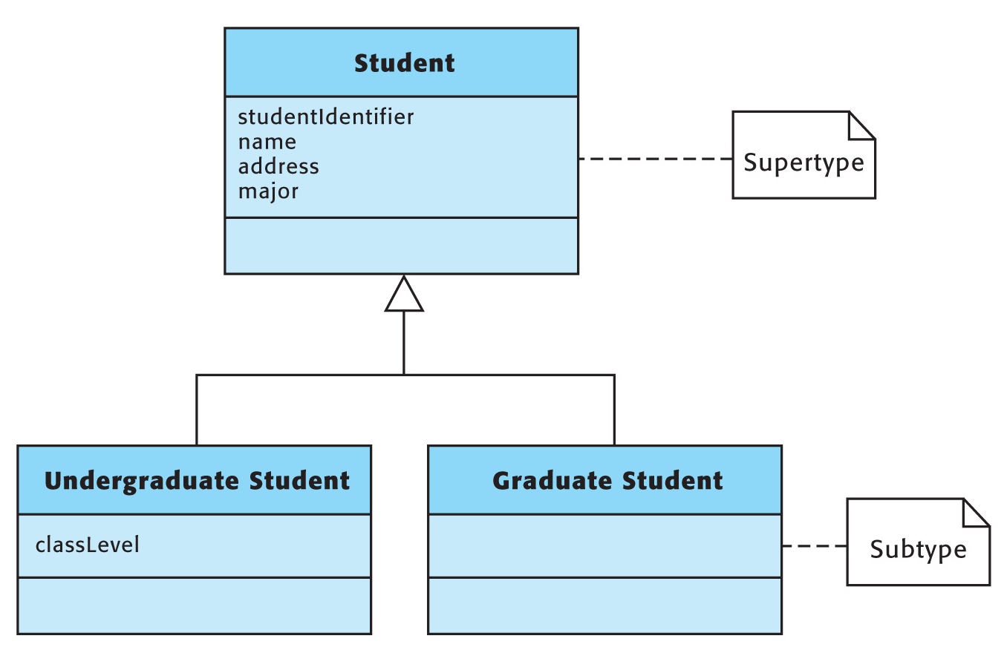
Generalization-Specialization Hierarchies (continued)
.

Slide 50

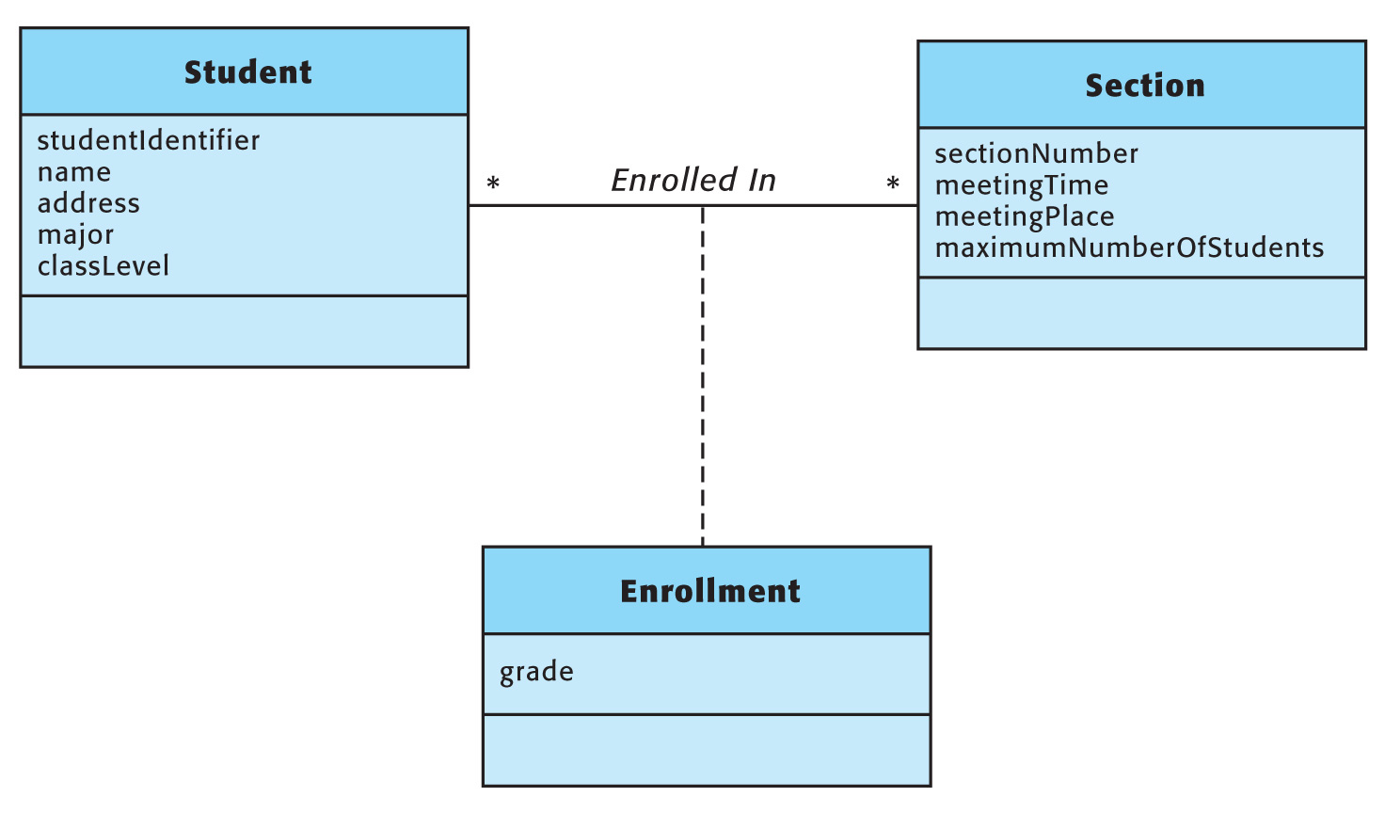
Association Concepts
Add an association concept to a domain model when you need to include an attribute which depends upon an association.

Slide 51
Creating a Domain Model
 Create a domain model one use case at a time;
 Then, merge them to form a complete domain model for the entire system.

Slide 52
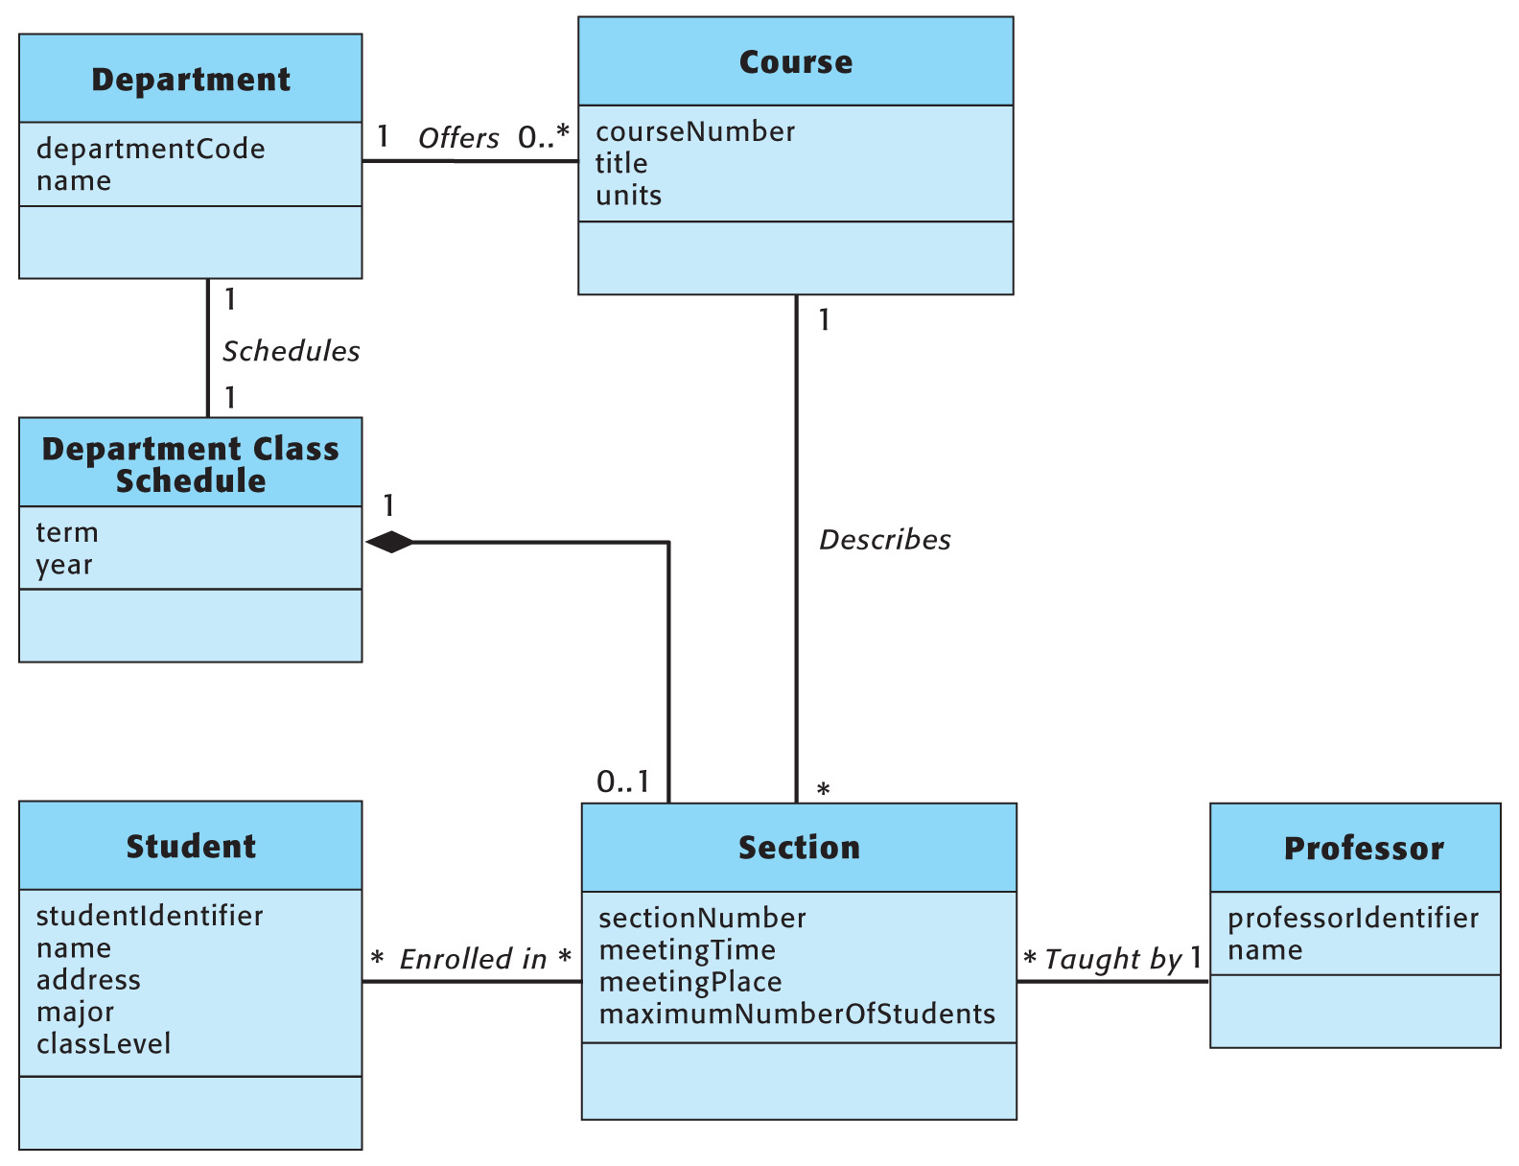
Domain Model

Slide 53

Bye

